Slide 1
Veranda Acacia Cloud and DevOps Program
Powered by Presented By
Edureka P.Mariarexiline

Slide 2
Main Objective
This Program prepares you to get job-ready and enhance your skills to match the industry standards.

Slide 3

What is Cloud?
The term “ cloud” refers to a network providing resources over the Internet. The resources present in the cloud can be used infinitely by the user whenever needed.

Slide 4








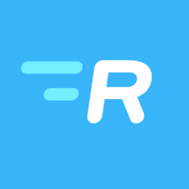
Who uses Cloud Services?
Pinterest
Amazon
Netflix
Spotify
Expedia
Dropbox
Maropost for Marketing
SlideRocket
Ratatype

Slide 5

What is DevOps?
DevOps is a set of practices that combines software development and IT applications.

Slide 6






Who uses DevOps?
Amazon
Netflix
Etsy
Target
NASA
Hertz
Facebook
Walmart
Sony Pictures Entertainment

Slide 7


CLOUD AND DEVOPS PROGRAM ROADMAP
Linux
AWS
Git
Jerkins
Ansible
Docker
Kubernetes
AWS DevOps

Slide 8
Unique to this program
Top-tech Employee-level Training
Lab Exercises
Content created by Industry Experts
Hands-on Training
Multiple Choice Questions
Do-It-Yourself (DIY) Tasks for each day

Slide 9
Program Structure
192 hours (17 weeks) program spread across 4 months
1.180 learning hrs 2.12 assesment hrs
6 days a week in the learning weeks
3 days a week in the assesment weeks
2 hours a day
2 hours live online masterclass on weekends, over and above the 192 hours.

Slide 10
Companies Hiring for Cloud and DevOps Engineer
PayPal
Capgemini
Amazon
MOTOROLA
Tech Mahindra
Accenture
VMware
HashiCorp

Slide 11
Cloud and DevOps Roles
Cloud Architect
Cloud administrator
Cloud developer
Cloud security professional
Chief cloud officer
Site Reliability Engineer (SRE)
Cloud Engineer
DevOps Engineer
Cloud Support Engineer
Platform Engineer
Building Engineer

Slide 12
Salary of Cloud and DevOps Engineer
Cloud Engineer salary in India ranges between ₹ 3.0 Lakhs to ₹ 12.4 Lakhs with an average annual salary of ₹ 5.4 Lakhs.
DevOps Engineer salary in India ranges between ₹ 4.2 Lakhs to ₹ 12.3 Lakhs with an average annual salary of ₹ 6.0 Lakhs

Slide 13
Future scope of Cloud and DevOps
DevOps has a great and promising future. The practical applications of DevOps are increasing day by day.
There is a growing market for DevOps in today’s time the market is expected to reach US$ 287.9 billion by 2026.
Cloud computing is that part of a business model that is taking the world by storm. Its ability to allow organizations to maintain flexibility, scale, and focus their efforts on business operations makes it very important for any business.

Slide 14
Eligibility Criteria
12th PASS
Undergraduate and Postgraduate Students
C, C++, JAVA
Computer Application Skills

Slide 15
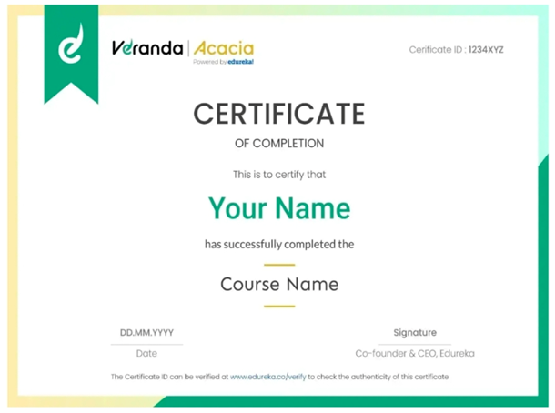
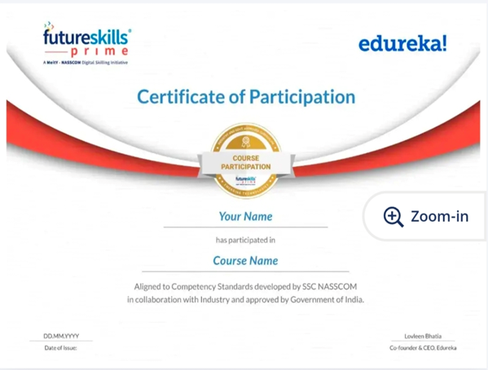
Sample Completion Certificate

Slide 16
Conclusion
At Edureka, we respect skill, knowledge and common sense. Not hierarchy. We are a family of fun and ambitious people with a desire to impart education, to stay committed to the core vision of Edureka.

Slide 17
Thanking You

